Slide 1


User Activity Data Analysis
Online Forum
01
02
03
04
05
Data Analysis Lifecycle
Requirements
Data Analysis Tools
Data Quality
Security & Ethics

Slide 2
Data Analysis Lifecycle
01
Question 1
Feedback
Which aspects of the data analysis lifecycle are you primarily involved with on this project?
This project goes through all the phases of the data analysis lifecycle
See next slide for the full data analysis lifecycle

Slide 3

Data Analysis Lifecycle
01
Data Insights
Analyse
Organise
Maintain
Acquire
Communicate
Transform

Slide 4
Data Analysis Lifecycle
01
Question 2
Feedback
What activities would you need to do before undertaking this project? Think about where the data came from.
Data Creation
Storage
Cleaning
Data Pre-Processing

Slide 5
Data Analysis Lifecycle
01
Question 3
What would you need to do to allow this analysis to be repeated with updated data, and how would this solution be maintained?
The SQL query will be updated to a database for re-use with updated data.
Ensure data conforms to the existing data structure

Slide 6
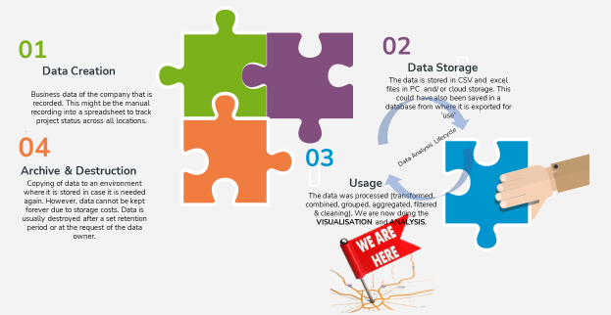
Data Analysis Lifecycle
01
Question 4
○ How does this project fit into a broader data lifecycle?

Slide 7
Requirements
02
Question 1
Feedback
What aspects of the requirements were not 100% clear to you?
How the analysis relate to the objectives of finding out how the site was being used

Slide 8
Requirements
02
Question 2
Feedback
Would it have been easier if you could talk directly to Oliver? If so, what sorts of questions would you want to ask him?
No.
The excel workbook provided was very detailed to understand the requirements

Slide 9
Requirements
02
Question 3
How did you analyse the requirements?
Explore the data –e.g. count rows
The SQL query type that was required was analysed
Single Table query
Cross Table Query

Slide 10
Data Analysis Tools
03
Question 1
Feedback
Were the tools you used appropriate for the job?
Yes
-Sqlite
-Python (Pandas)
-Jupyter Notebook (IDE)

Slide 11
Data Analysis Tools
03
Question 2
Feedback
Why was SQLite used over PostgreSQL for this project?
PostgreSQL is used as production databases
Since this an ad-hoc activity, it is preferred not to have access to production PostgreSQL database
* Security * Privacy *

Slide 12
Data Analysis Lifecycle
01
Question 3
What are the benefits of adopting relational database technologies for an IT organisation?
Only one version of data
Remove data duplication and redundancies
Data integrity

Slide 13
Data Quality
04
Question 1
Feedback
What did you think of the organisation of the source data and how that mapped to the structure of your database?
Was there a natural mapping from the CSV files to the database tables?
Yes
The CSV file had been structured to be mapped into the required database structure.
CSV
Dataframe
Database

Slide 14
Data Quality
04
Question 2
Feedback
Was the data consistent? In other words, were there any issues with the data that prevented you from producing good quality results?
Data had been cleaned and format the data into three separate CSV files -posts, comments and users.
Consistent Data

Slide 15
Data Quality
04
Question 3
There was no data dictionary provided
Did you find the definitions of the data were detailed enough to assist you in the tasks?
However, field names were intuitive enough for the task
Feedback

Slide 16
Data Quality
04
Melanie
Point of Contact for data quality issues.
Question 3
What steps would you take to ensure that any concerns about data quality are dealt with appropriately?
Who would you talk to about this?
Database
Quality Data
Ensure Referential Integrity
Clean Data
Remove duplicates
Explore for other quality issues

Slide 17
Security, Ethics & Legislation
05
Question 1
Feedback
Was the data sufficiently masked, or are there personal details present in the data?
Yes
UserId and Pseudo names as DisplayName
Facilitate the masking of the user’s identify
Yes
Profile Image URL

Slide 18
Security, Ethics & Legislation
05
Question 2
Feedback
Can you think of possible techniques (e.g. statistics) that could unmask the participants in this data?
No.
Except access to a table containing the users real names

Slide 19
05
Security, Ethics & Legislation
Question 3
Are there any ethical considerations with our intended use of this data?
Privacy Policy-Are users aware of how data will be used?
Use of the data is to improve a service already subscribed to by the users.
The comments are public information

Slide 20
05
Security, Ethics & Legislation
Question 4
Is the use of this data covered by any legislation, and if so, what is that legislation?
Yes
GDPR –General Data Protection Regulation EU & UK
Data protection by design and default (Privacy by Design)

